Slide 1
AVL Tree
Course No. 009954
Credit Hours: 4
Class Hour: Friday 9-11 am
Course Prerequisite: Basic Programming
Office Hours: Monday – Thursday: 1:30 am – 3:00 pm

Slide 2
AVL Tree
An AVL tree (named after inventors GM Adelson-Velsky and EM Landis-1962) is a self-balancing binary search tree (BST).
AVL Tree can be defined as height balanced binary search tree in which each node is associated with a balance factor which is calculated by subtracting the height of its right sub-tree from that of its left sub-tree.
Tree is said to be balanced if balance factor of each node is in between -1 to 1, otherwise, the tree will be unbalanced and need to be balanced.

Slide 3
Balance Factor
If balance factor of any node is 1, it means that the left sub-tree is one level higher than the right sub-tree.
If balance factor of any node is 0, it means that the left sub-tree and right sub-tree contain equal height.
If balance factor of any node is -1, it means that the left sub-tree is one level lower than the right sub-tree.
An AVL tree is given in the next slide. We can see that, balance factor associated with each node is in between -1 and +1. therefore, it is an example of AVL tree.
Balance Factor (k) = height (left(k)) - height (right(k))

Slide 4
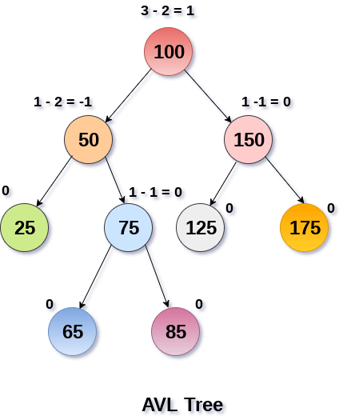
Example

Slide 5
Why AVL Tree?
AVL tree controls the height of the binary search tree by not letting it to be skewed. The time taken for all operations in a binary search tree of height h is O(h). However, it can be extended to O(n) if the BST becomes skewed (i.e., worst case). By limiting this height to log n, AVL tree imposes an upper bound on each operation to be O(log n) where n is the number of nodes.

Slide 6
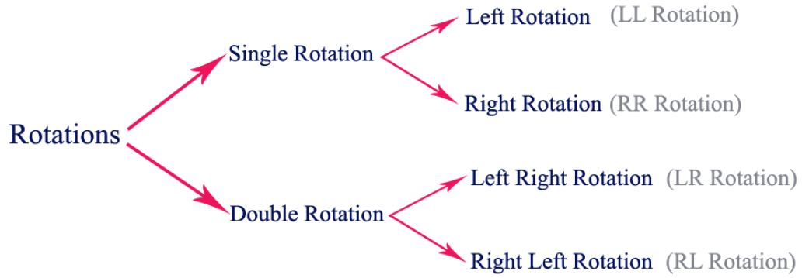
AVL Rotations
We perform rotation in AVL tree only in case if Balance Factor is other than (-1, 0, and 1). There are basically four types of rotations which are as follows:
L L rotation: Inserted node is in the left subtree of left subtree of A
R R rotation : Inserted node is in the right subtree of right subtree of A
L R rotation : Inserted node is in the right subtree of left subtree of A
R L rotation : Inserted node is in the left subtree of right subtree of A
The first two rotations LL and RR are single rotations and the next two rotations LR and RL are double rotations.
For a tree to be unbalanced, minimum height must be at least 2, Let us understand each rotation
Where node A is the node whose balance Factor is other than -1, 0, 1.

Slide 7
1. RR Rotation
When BST becomes unbalanced, due to a node is inserted into the right subtree of the right subtree of A, then we perform RR rotation, RR rotation is an anticlockwise rotation, which is applied on the edge below a node having balance factor -2.
In this example, node A has balance factor -2 because a node C is inserted in the right subtree of A right subtree. We perform the RR rotation on the edge below A.

Slide 8
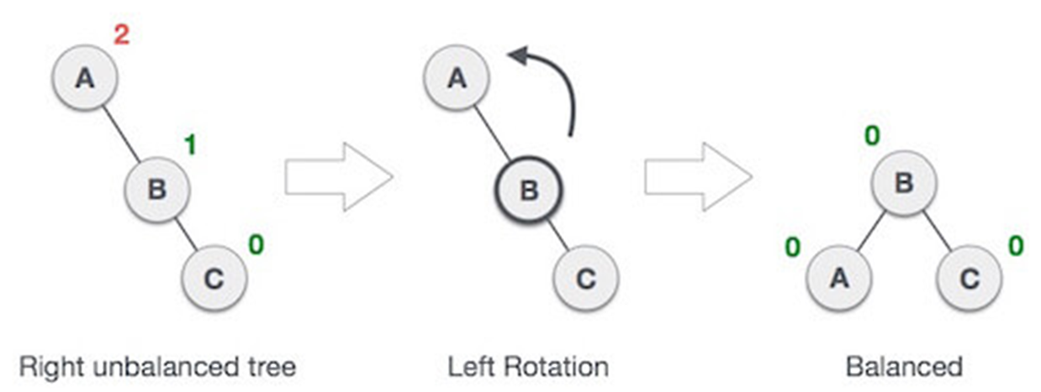
1. RR Rotation

Slide 9
2. LL Rotation
When BST becomes unbalanced, due to a node is inserted into the left subtree of the left subtree of C, then we perform LL rotation, LL rotation is clockwise rotation, which is applied on the edge below a node having balance factor 2.
In this example, node C has balance factor 2 because a node A is inserted in the left subtree of C left subtree. We perform the LL rotation on the edge below A.

Slide 10
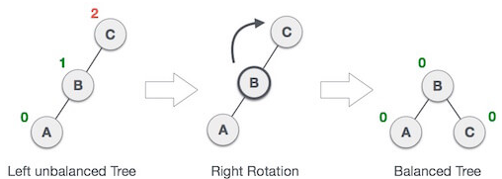
2. LL Rotation

Slide 11
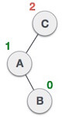
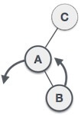
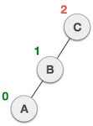
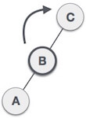
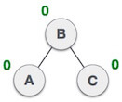
3. LR Rotation
Double rotations are bit tougher than single rotation which has already explained above. LR rotation = RR rotation + LL rotation, i.e., first RR rotation is performed on subtree and then LL rotation is performed on full tree, by full tree we mean the first node from the path of inserted node whose balance factor is other than -1, 0, or 1.

Slide 12
3. LR Rotation

Slide 13
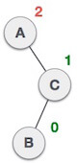
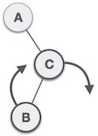
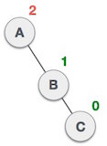
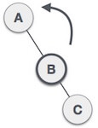
4. RL Rotation
As already discussed, that double rotations are bit tougher than single rotation which has already explained above. R L rotation = LL rotation + RR rotation, i.e., first LL rotation is performed on subtree and then RR rotation is performed on full tree, by full tree we mean the first node from the path of inserted node whose balance factor is other than -1, 0, or 1.

Slide 14
4. RL Rotation

Slide 15
Operations on AVL tree
Due to the fact that, AVL tree is also a binary search tree therefore, all the operations are performed in the same way as they are performed in a binary search tree. Searching and traversing do not lead to the violation in property of AVL tree. However, insertion and deletion are the operations which can violate this property and therefore, they need to be revisited.
1 | Insertion | Insertion in AVL tree is performed in the same way as it is performed in a binary search tree. However, it may lead to violation in the AVL tree property and therefore the tree may need balancing. The tree can be balanced by applying rotations.
2 | Deletion | Deletion can also be performed in the same way as it is performed in a binary search tree. Deletion may also disturb the balance of the tree therefore; various types of rotations are used to rebalance the tree.

Slide 16

Time Complexity

Slide 17
Advantages vs Disadvantages
AVL tree is a height-balanced tree and therefore, the height of the tree never grows more than N where N is the number of nodes in the tree
AVL trees have efficient search time complexity
AVL trees are very difficult to implement

Slide 18
Application of AVL Trees
AVL tree is used when there are few operations of insertion and deletion are performed
It is widely used for sorting sets and dictionary data
AVL trees are beneficial in cases like a database where insertions and deletions are not that frequent, but you frequently check for entries.

Slide 19
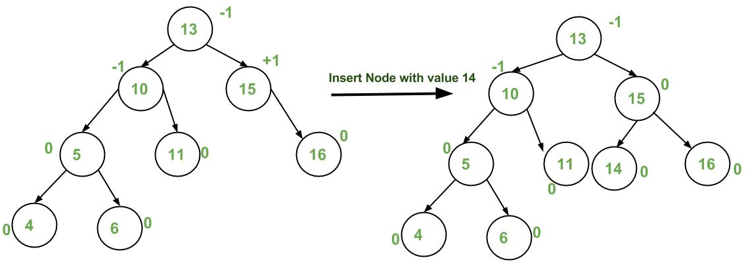
Illustration of Insertion at AVL Tree

Slide 20
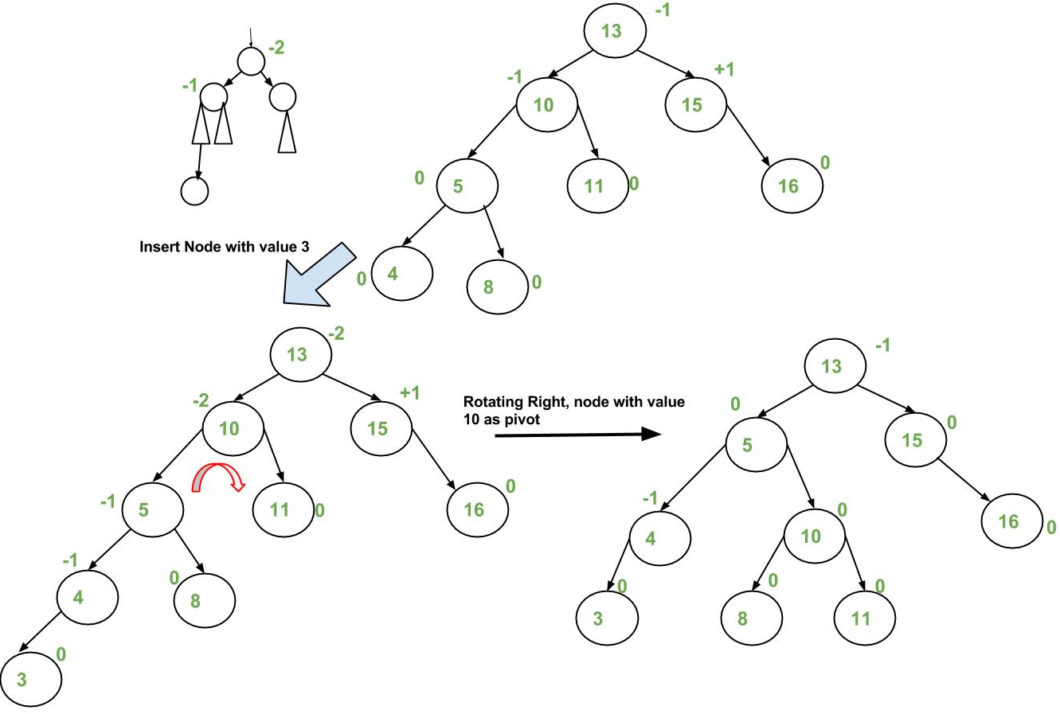
Illustration of Insertion at AVL Tree

Slide 21
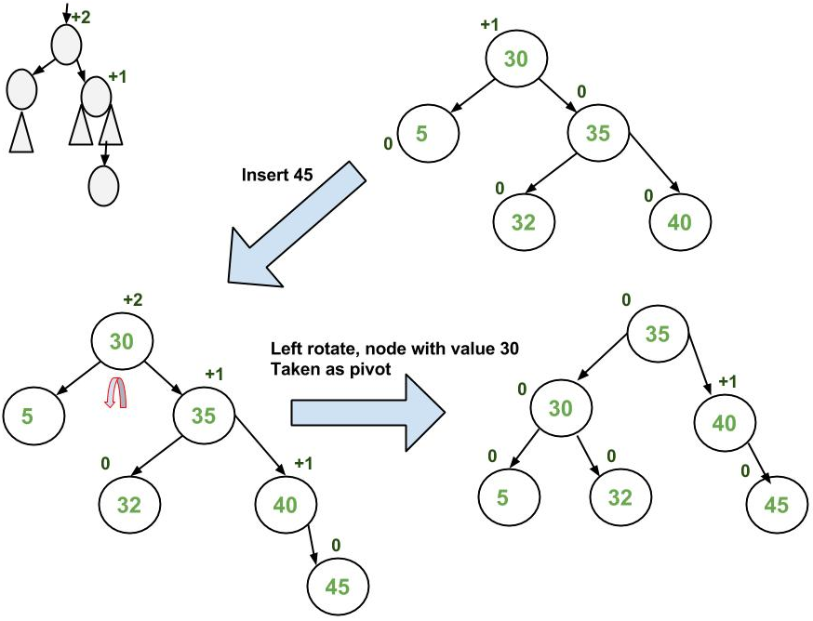
Illustration of Insertion at AVL Tree

Slide 22
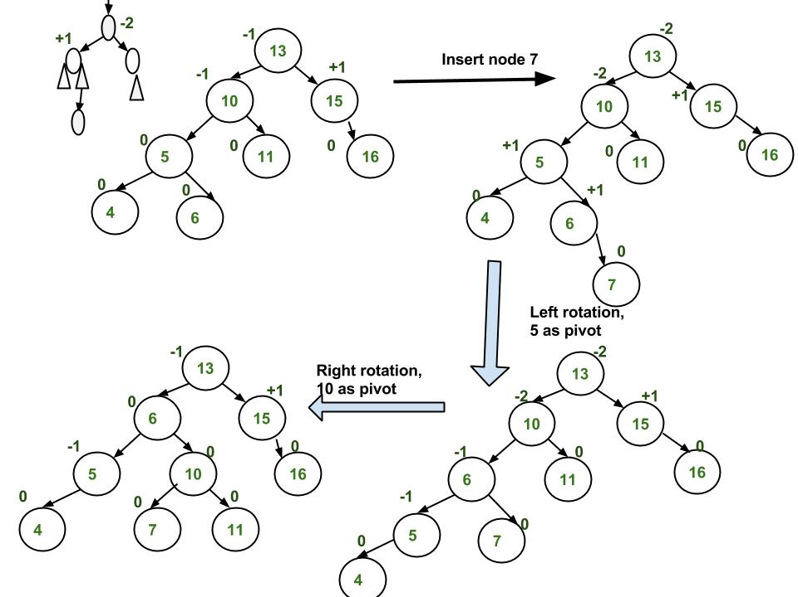
Illustration of Insertion at AVL Tree

Slide 23
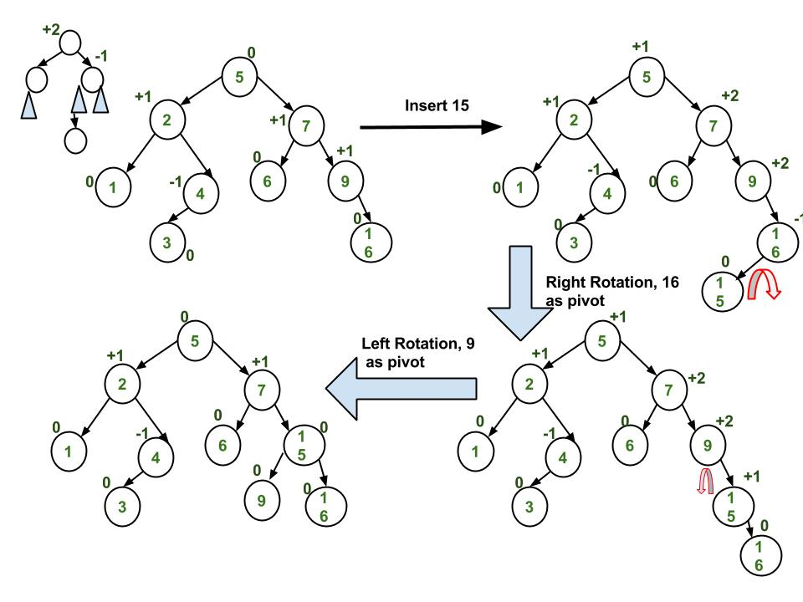
Illustration of Insertion at AVL Tree

Slide 24
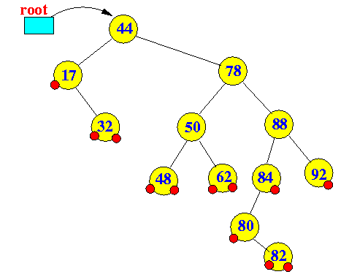
Illustration of Deletion at AVL Tree
Deleting a leaf node (no children nodes): easy, just delete away....
Deleting a node with 1 child node: easy, connect its parent and child....
Deleting a node with 2 children nodes:
A node's in-order successor of a node with 2 children is the left-most child of its right subtree
A node's in-order predecessor of a node with 2 children is the right-most child of its left subtree

Slide 25
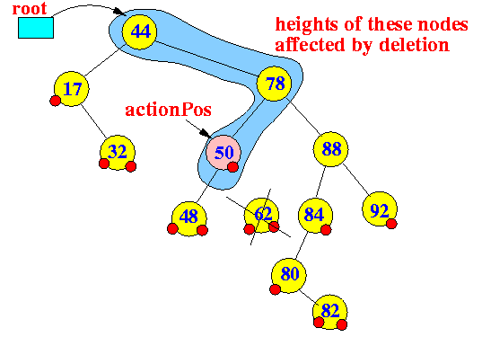
Deleting a leaf node (no children nodes): easy, just delete away....
Delete 62
The action position is a reference to the parent node from which a node has been physically removed
The action position indicate the first node whose height has been affected (possibly changed) by the deletion
(This will be important in the re-balancing phase to adjust the tree back to an AVL tree)

Slide 26
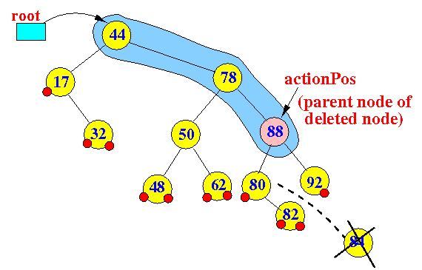
Deleting a node with 1 child node: easy, connect its parent and child...
Delete 84

Slide 27
Deleting a node with 2 children nodes
Replace the (to-delete) node with its in-order predecessor or in-order successor
A node's in-order successor of a node with 2 children is the left-most child of its right subtree
A node's in-order predecessor of a node with 2 children is the right-most child of its left subtree

Slide 28
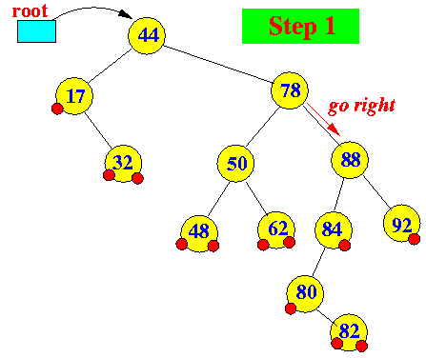
deleting using the to-delete node with its in-order successor
Delete 78

Slide 29
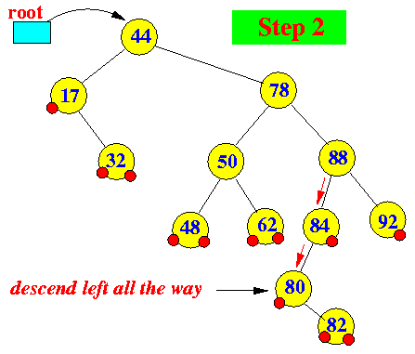
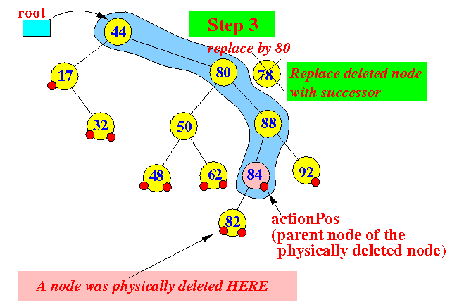
deleting using the to-delete node with its in-order successor

Slide 30
Illustration of Deletion at AVL Tree
14
8 , 7 , 11 , 14 , 17
11
19
7
12
17
53
8
13
16
20
60
4

Slide 31
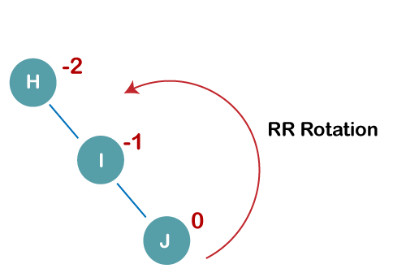
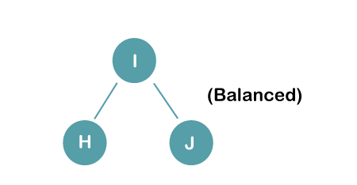
Q: Construct an AVL tree having the following elements H, I, J, B, A, E, C, F, D, G, K, L
1. Insert H, I, J

Slide 32
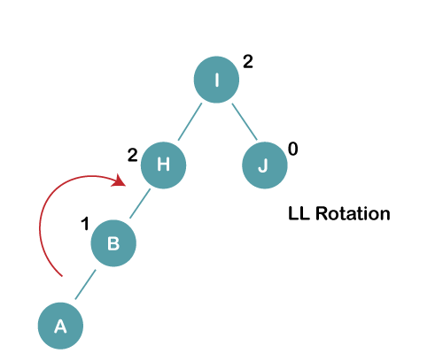
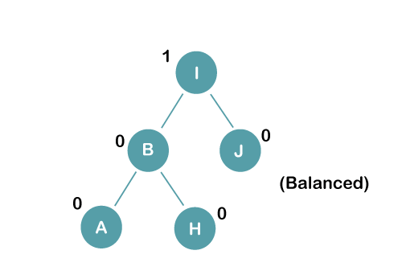
Q: Construct an AVL tree having the following elements H, I, J, B, A, E, C, F, D, G, K, L
2. Insert B, A

Slide 33
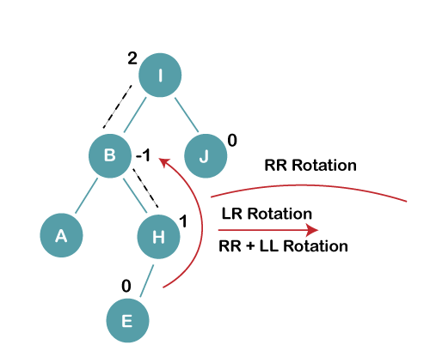
Q: Construct an AVL tree having the following elements H, I, J, B, A, E, C, F, D, G, K, L
3. Insert E

Slide 34
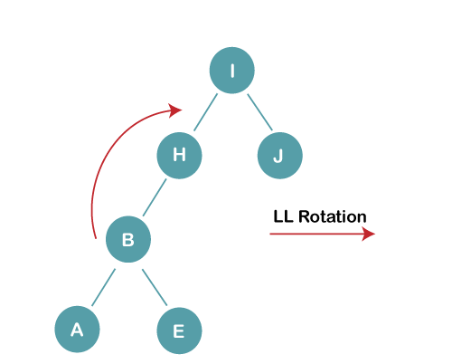
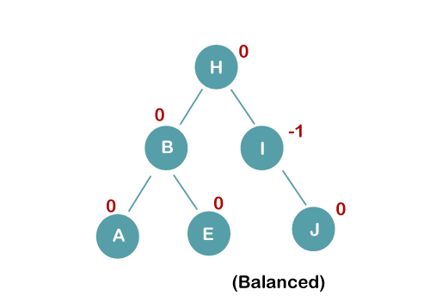
Q: Construct an AVL tree having the following elements H, I, J, B, A, E, C, F, D, G, K, L
3 a) We first perform RR rotation on node B
3b) We first perform LL rotation on the node I

Slide 35
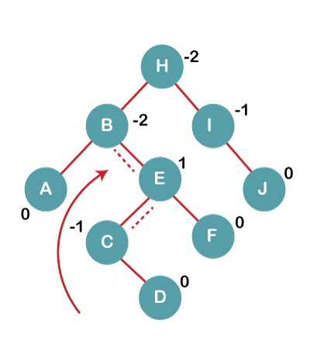
Q: Construct an AVL tree having the following elements H, I, J, B, A, E, C, F, D, G, K, L
4. Insert C, F, D

Slide 36
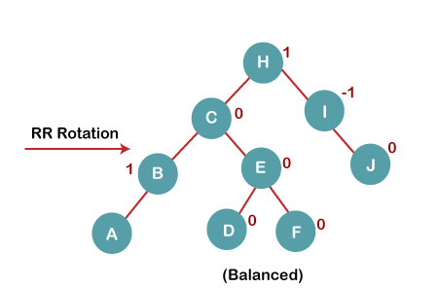
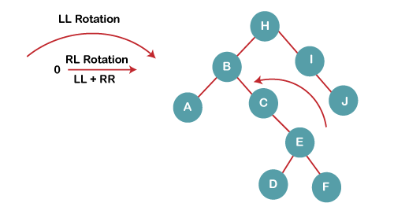
Q: Construct an AVL tree having the following elements H, I, J, B, A, E, C, F, D, G, K, L
4a) We first perform LL rotation on node E
4b) We then perform RR rotation on node B

Slide 37
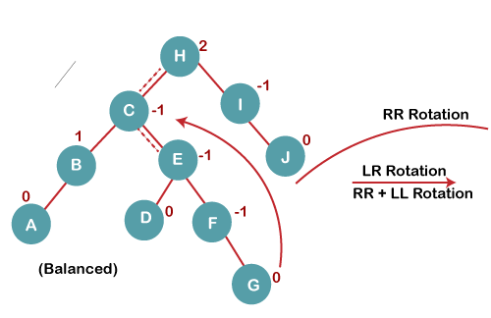
Q: Construct an AVL tree having the following elements H, I, J, B, A, E, C, F, D, G, K, L
5. Insert G

Slide 38
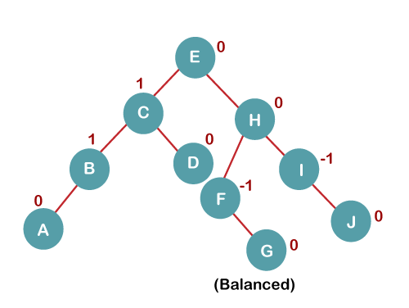
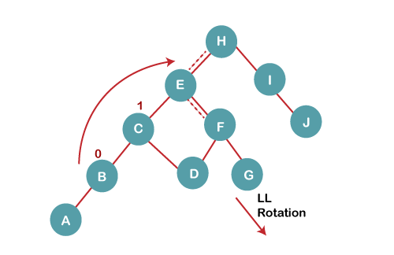
Q: Construct an AVL tree having the following elements H, I, J, B, A, E, C, F, D, G, K, L
5 a) We first perform RR rotation on node C
5 b) We then perform LL rotation on node H

Slide 39
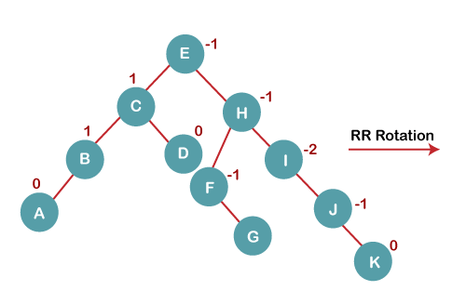
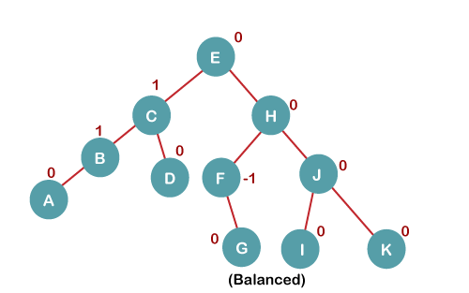
Q: Construct an AVL tree having the following elements H, I, J, B, A, E, C, F, D, G, K, L
6. Insert K

Slide 40
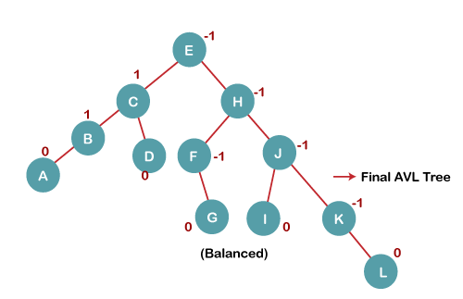
Q: Construct an AVL tree having the following elements H, I, J, B, A, E, C, F, D, G, K, L
7. Insert L

Slide 41
Illustration of Insertion at AVL Tree
// C program to insert a node in AVL tree
#include<stdio.h>
#include<stdlib.h>
// An AVL tree node
struct Node
{
int key;
struct Node *left;
struct Node *right;
int height;
};
// A utility function to get the height of the tree
int height(struct Node *N)
{
if (N == NULL)
return 0;
return N->height;
}
// A utility function to get maximum of two integers
int max(int a, int b)
{
return (a > b)? a : b;
}
/* Helper function that allocates a new node with the given key and
NULL left and right pointers. */
struct Node* newNode(int key)
{
struct Node* node = (struct Node*)
malloc(sizeof(struct Node));
node->key = key;
node->left = NULL;
node->right = NULL;
node->height = 1; // new node is initially added at leaf
return(node);
}
// A utility function to right rotate subtree rooted with y
// See the diagram given above.
struct Node *rightRotate(struct Node *y)
{
struct Node *x = y->left;
struct Node *T2 = x->right;
// Perform rotation
x->right = y;
y->left = T2;
// Update heights
y->height = max(height(y->left),
height(y->right)) + 1;
x->height = max(height(x->left),
height(x->right)) + 1;
// Return new root
return x; }
// A utility function to left rotate subtree rooted with x
// See the diagram given above.
struct Node *leftRotate(struct Node *x)
{
struct Node *y = x->right;
struct Node *T2 = y->left;
// Perform rotation
y->left = x;
x->right = T2;
// Update heights
x->height = max(height(x->left),
height(x->right)) + 1;
y->height = max(height(y->left),
height(y->right)) + 1;
// Return new root
return y;
}
// Get Balance factor of node N
int getBalance(struct Node *N)
{
if (N == NULL)
return 0;
return height(N->left) - height(N->right);
}

Slide 42
Illustration of Insertion at AVL Tree
// Recursive function to insert a key in the subtree rooted
// with node and returns the new root of the subtree.
struct Node* insert(struct Node* node, int key)
{
/* 1. Perform the normal BST insertion */
if (node == NULL)
return(newNode(key));
if (key < node->key)
node->left = insert(node->left, key);
else if (key > node->key)
node->right = insert(node->right, key);
else // Equal keys are not allowed in BST
return node;
/* 2. Update height of this ancestor node */
node->height = 1 + max(height(node->left),
height(node->right));
/* 3. Get the balance factor of this ancestor
node to check whether this node became
unbalanced */
int balance = getBalance(node);
// If this node becomes unbalanced, then
// there are 4 cases
// Left Left Case
if (balance > 1 && key < node->left->key)
return rightRotate(node);
// Right Right Case
if (balance < -1 && key > node->right->key)
return leftRotate(node);
// Left Right Case
if (balance > 1 && key > node->left->key)
{
node->left = leftRotate(node->left);
return rightRotate(node);
}
// Right Left Case
if (balance < -1 && key < node->right->key)
{
node->right = rightRotate(node->right);
return leftRotate(node);
}
/* return the (unchanged) node pointer */
return node;
}
// A utility function to print preorder traversal
// of the tree.
// The function also prints height of every node
void preOrder(struct Node *root)
{
if(root != NULL)
{
printf("%d ", root->key);
preOrder(root->left);
preOrder(root->right);
}
}
/* Driver program to test above function*/
int main()
{
struct Node *root = NULL;
/* Constructing tree given in the above figure */
root = insert(root, 10);
root = insert(root, 20);
root = insert(root, 30);
root = insert(root, 40);
root = insert(root, 50);
root = insert(root, 25);
/* The constructed AVL Tree would be
30
/ \
20 40
/ \ \
10 25 50
*/
printf("Preorder traversal of the constructed AVL"
" tree is \n");
preOrder(root);
return 0;
}
Output
Preorder traversal of the constructed AVL tree is
30 20 10 25 40 50
Complexity Analysis
Time Complexity: O(log(n)), For Insertion

Slide 43


